Slide 1
Welcome to Elkridge Landing Middle School

Slide 2
Vision:
Elkridge Landing Middle School is a place where students, staff, parents, and community members work together to foster a supportive and engaging environment in which students are inspired and empowered to excel.
Mission:
*Students will accept responsibility for their own continuous improvement.
*Staff will implement the best available instructional practices and resources in their classrooms.
*Parents and community members will partner with school staff to support school improvement initiatives.
Welcome!

Slide 3
ADMINISTRATIVE TEAM
David Strothers, Principal
david_strothers@hcpss.org
Amy Thorne-Assistant Principal
amy_thorne@hcpss.org
410-313-5022 - Front Office
410-313-5042 - Student Services
410-313-5029 - Fax

Slide 4
PTA
President- Christina Wilson
Please join the PTA
Support PTSA fundraisers
Notes:
Table in the hall- stop by and fill out a membership form!

Slide 5
WHO IS MY CHILD’S COUNSELOR?
A-L – Karissa Ressler
karissa_ressler@hcpss.org
M-Z - Melissa Cheadle
melissa_cheadle@hcpss.org
Student Services - 410-313-5043
Available for consultation regarding academic progress, attendance issues, & student behavior concerns.

Slide 6
OUTDOOR EDUCATION- SANDY HILL OCTOBER 24TH-26TH
Price $150 student; $110 chaperones
General Info packet distributed Sept. 7th
General Info Parent Meeting Sept. 11th at 6pm in the Cafeteria
Please come to this meeting if you have questions about your child attending ODE
Parent Chaperone Only Info. Night Oct 11th at 7:00 pm
Oct 23rd ODE Pack up” 4-6 pm (upper parking lot)
Direct your questions to Chelsea Rossi

Slide 7
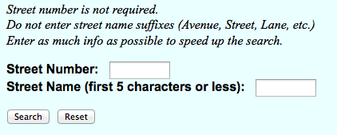
WHERE DO I FIND BUS ROUTES?
www.hcpss.org
Make sure your child knows their bus #

Slide 8
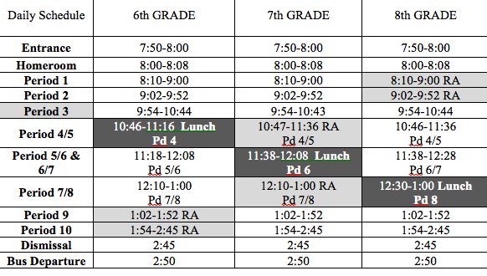
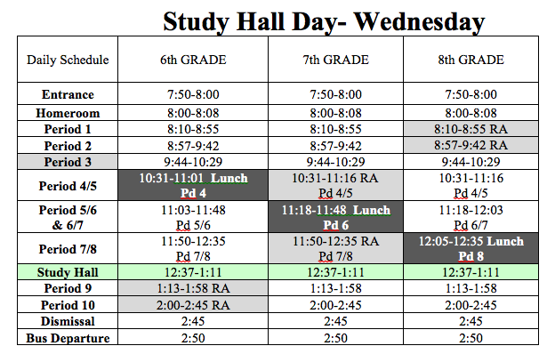
DAILY SCHEDULE

Slide 9
First Day Procedures
Where does my child enter the building?
6th Grade enters through the double doors by the stairs (left of main doors)
7th Grade enters through the main doors
8th Grade enters through the doors on the right near the cafeteria
Where do they go on the first day?
6th Grade goes straight to their homeroom
7th Grade ---> reports to the cafeteria
8th Grade ---> reports to the gym

Slide 10
LUNCH
Make sure your child has a lunch or money to purchase a lunch each day
Breakfast $2.00
Lunch $3.25
Milk $.50
Your child will get to choose a table. Sign-ups will take place after the first week or so
Point of Sale System (POS)- students will use their codes from previous years
Cash will still be accepted throughout the school year
Payments can be made online through an app or students can bring in money to add to their account
myschoolbucks.com
Please keep track of account funds
Turnover isn’t immediate
Copy of codes for students who forget

Slide 11
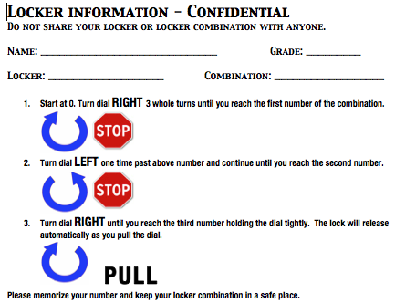
WHEN DOES MY CHILD GET A LOCKER?
6th grade get their lockers today!
7th and 8th grades are assigned as soon as their Drug Policy & Computer Usage Forms are signed & returned
Please remind your child to protect their combination
Students are not permitted to share lockers
Notes:
If you are helping your child with their locker- as they approach the 3rd number in the combination the lock will “tighten” when it clicks- they can open the locker. There is no lever/latch they need to pull

Slide 12
DOES THE SCHOOL HAVE A DRESS CODE?
Unduly exposes or reveals skin or undergarments.
Causes or is likely to cause a substantial or material disruption to school activities or the orderly operation of the school.
Covers the head, including hats, bandanas, hoods and visors.
Depicts profanity, obscenity, the use of weapons, or violence.
Promotes use of tobacco, drugs, alcohol products or implies or contains sexually suggestive messages
Depicts gang affiliation.
Contains rude, disrespectful, or discourteous expressions inconsistent with civil discourse and behavior.

Slide 13
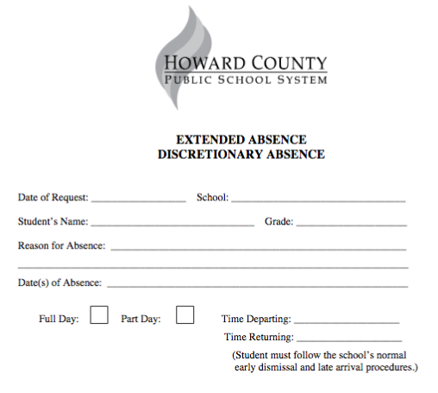
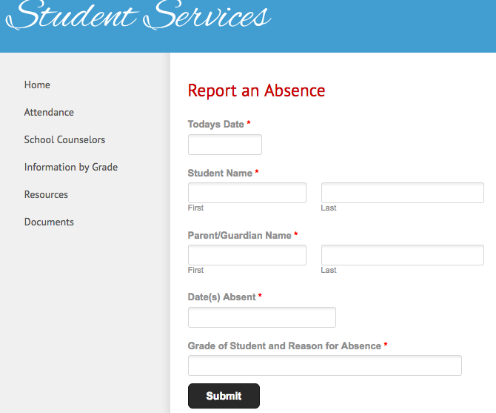
WHAT DO I DO IF MY CHILD IS LATE OR ABSENT?
Call the school- 410-313-5043 or use the link on our website to report an absence
Note must be given to Student Services upon returning to school
Sign in your child in office if they are late
Discretionary / Extended Absence forms are available online

Slide 14
HOW CAN I BEST SUPPORT MY CHILD?
Ensure regular attendance
Establish daily homework routines
Review the agenda book regularly
Each week, review class grades with your child using Canvas
Attend teacher conferences
Discuss student strengths (Naviance)
Trust, but verify!
Notes:
24-hour rule
Check Canvas weekly for grades- have you child present their grades to you!

Slide 15
Notes:
Please go to HCPSS Connect and update your family file prior to the first day. We have 460 families that have not done it yet!

Slide 16
WHAT IS PBIS?
PBIS
Framework to encourage student responsibility, preparedness and respect.
Our core values focus on recognizing students.

Slide 17
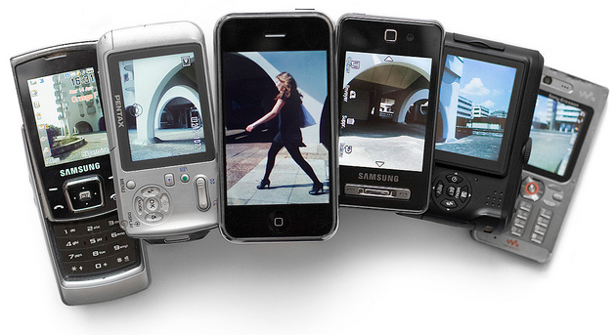
HCPSS Guidelines
Students must comply with class & school rules and all relevant HCPSS Board Policies (Responsible Use of Technology & Social Media, Technology Security)
Student can use their personal devices
Before homeroom
During lunch/recess
After dismissal
In class as instructed by the teacher

Slide 18
ELMS Cell Phone/Device Policy
Whether intentional or not, the phone/device can remove us socially, intellectually, and emotionally from being present with those we are with.
In order to keep distractions to a minimum and the focus on learning, cell phones, just like any other device, should not be accessed unless the teacher has given directions to access technology for instructional purposes. If a teacher does not explicitly tell the students to hold/use your phone/device, it must be placed on the desk, in a pocket, in your binder etc, out of your hands.
Word of Advice: Please don’t text your child during class, wait until their lunch.
Recommendations: Don’t text child while at school.

Slide 19
IPADS
Due to a lack of inventory, students will not be assigned an iPad.
iPad carts will be in the classroom this year.
Students can bring a device from home, but not required.

Slide 20
SOCIAL NETWORKING- CAUTIONS
13 years old- Age requirement
#1 cause of stress in teenagers is social media
Issues in school start on social media
Trust, but verify!

Slide 21
Follow us on Twitter

Slide 22
Back To School Night
September 13th
7 PM

Slide 23
WHAT SHOULD YOU DO WHEN YOU MEET UP WITH YOUR CHILD?
Practice opening locker.
Please remember -
Students will have plenty of practice opening their locker and will have assistance finding their classes. They do not need to master these skills this afternoon.
Schedules are changing as we speak because we were able to hire 3 new staff members. Your child will be given their schedule on the first day of school. At 2:30 we kindly ask you to exit the building.

